Slide 1
Instructor Materials Chapter 7: Networking Concepts
IT Essentials v6.0
Notes:
Cisco Networking Academy Program
IT Essentials
Chapter 7: Networking Concepts

Slide 2
Instructor Materials - Chapter 7 Planning Guide
This PowerPoint is divided in two parts:
Instructor Planning Guide
Information to help you become familiar with the chapter
Teaching aids
Instructor Class Presentation
Optional slides that you can use in the classroom
Begins on slide #11
Note: Remove the Planning Guide from this presentation before sharing with anyone.
Notes:
2

Slide 3
ITE 6.0 Planning Guide
Chapter 7: Networking Concepts
Notes:
ITE 6.0 Planning Guide
Chapter 7: Networking Concepts

Slide 4
Chapter 7: Activities
What activities are associated with this chapter?
Page Number | Activity Type | Activity Name
7.1.1.5 | Interactive Activity (IA) | Identify Network Devices and Media Representations
7.1.2.8 | IA | Network Types
7.2.1.9 | IA | Place the OSI and TCP/IP Model Layers
7.3.1.6 | IA | Identify Network Devices
7.3.2.5 | IA | Cable Pinouts
7.3.2.6 | Lab | Build and Test Network Cables
Notes:
4

Slide 5
Chapter 7: Activities (Cont.)
What activities are associated with this chapter?
Page Number | Activity Type | Activity Name
7.3.2.7 | Packet Tracer | Cabling a Simple Network
7.4.1.7 | Video | IPv4 vs. IPv6
7.4.1.11 | Lab | Configure a NIC to Use DHCP in Windows
7.4.1.2 | Packet Tracer | Adding Computers to an Existing Network
7.4.2.7 | IA | TCP vs. UDP
7.4.2.8 | IA | Protocol Definitions and Default Ports
The password used in the Packet Tracer activities in this chapter is: PT_ITE!
Notes:
5

Slide 6
Chapter 7: Assessment
Students should complete Chapter 7, “Assessment” after completing Chapter 7.
Quizzes, labs, Packet Tracers and other activities can be used to informally assess student progress.
Notes:
6

Slide 7
Chapter 7: Best Practices
Prior to teaching Chapter 7, the instructor should complete Chapter 7, “Assessment.”
The goals of this chapter are to be able to explain the operation of computer networks and to be able to connect two PCs together in a network.
Students should be able to identify and explain the basic operation of network components including host devices, intermediary devices, and network media.
Make sure students understand the various types of networks. Have them provide examples of PANs, LANs, WANs, etc.
Have students diagram their home network on a white board, sheet of paper, or graphics program.
Students should be able to order the layers of the OSI and TCP/IP models, side by side.
Notes:
7

Slide 8
Chapter 7: Best Practices (Cont.)
Make sure students can explain the details of the encapsulation process as data travels down the layers of the OSI model.
Have students identify the network and host portion of IPv4 and IPv6 addresses.
Make sure students know how to access the TCP/IP settings in Windows so that they can set a computer to receive its IP addressing automatically.
Make sure students can connect two PCs together, apply appropriate addressing, and ping between them.
Students should be able to compare the operation of TCP and UDP and give examples of applications that use each.
Notes:
8

Slide 9
Chapter 7: Additional Help
For additional help with teaching strategies, including lesson plans, analogies for difficult concepts, and discussion topics, visit the ITE Community at community.netacad.net.
If you have lesson plans or resources that you would like to share, upload them to the ITE Community in order to help other instructors.
Notes:
9

Slide 10
Chapter 5: Topics in chapter that are not found in the CompTIA A+ 220-901 Certification
This slide lists content included in this chapter that is NOT listed in the CompTIA A+ 220-901 blueprint. Instructors could skip these sections; however, they should provide additional information and fundamental concepts to assist the student with the topic.
All content in Chapter 7 is aligned to the certification.
Notes:
10

Slide 11


Slide 12
Chapter 7: Networking Concepts
IT Essentials v6.0
Notes:
Cisco Networking Academy Program
IT Essentials
Chapter 7: Networking Concepts

Slide 13
Chapter 7 - Sections & Objectives
7.1 Principles of Networking
Explain components and types of computer networks.
7.2 Networking Standards
Explain the purpose and characteristics of networking standards.
7.3 Physical Components of a Network
Explain the purpose of physical components of a network.
7.4 Basic Networking Concepts and Technologies
Configure network connectivity between PCs.
7.5 Chapter Summary
Notes:
13

Slide 14
7.1 Principles of Networking
Notes:
Cisco Networking Academy Program
IT Essentials
Chapter 7: Networking Concepts

Slide 15





Principles of Networking Computer Networks
Computer Network Devices and Components
Host Devices – any device that sends and receives information on the network (computer, printer, etc.)
Intermediary Devices – exist in between host devices
Media – component over which the message travels from source to destination
Can you name each device or component shown here?
Notes:
7.1 - Principles of Networking
7.1.1 - Computer Networks

Slide 16
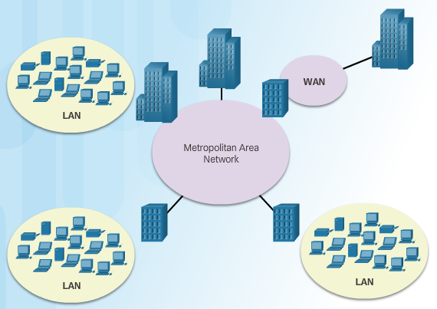
Principles of Networking Types of Networks
Major types of networks include:
Local Area Networks (LANs)
Wireless Local Area Networks (WLANs)
Personal Area Networks (PANs)
Metropolitan Area Networks (MANs)
Wide Area Networks (WANs)
Peer-to-Peer Networks
No dedicated servers
Each computer decides which resources to share
No central administration or security
Client-Server Networks
Server with software installed for client access
Resources controlled by centralized administrator
Notes:
7.1 - Principles of Networking
7.1.2 - Types of Networks

Slide 17
7.2 Networking Standards
Notes:
Cisco Networking Academy Program
IT Essentials
Chapter 7: Networking Concepts

Slide 18



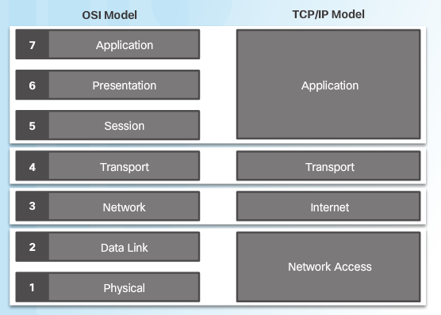
Networking Standards Reference Models
Organizations, such as lEEE, IETF, and ISO, develop open standards for networks so that any client running any operating system can access network resources.
The OSI model and the TCP/IP model are both reference models used to describe the data communication process.
As application data is passed down through the layers, protocol information is added at each level. This is known as the encapsulation process.
Notes:
7.2 - Networking Standards
7.2.1 - Reference Models

Slide 19
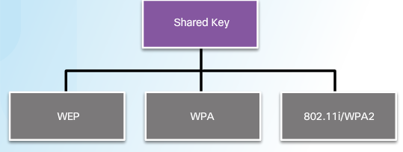
Networking Standards Wired and Wireless Standards
When Ethernet operates in half-duplex, the IEEE 802.3 standard specifies that a network implement the Carrier Sense Multiple Access with Collision Detection (CSMA/CD) access control method.
The 802.3 standard also specifies cable types for Ethernet including:
10Base-T
100Base-TX
1000Base-T
10GBase-T
The IEEE 802.11 standard specifies that wireless LANs use Carrier Sense Multiple Access with Collision Avoidance (CSMA/CA).
WLAN standards include 802.11a, 802.11b, 802.11g, 802.11n, and 802.11ac
When configuring an 802.11 WLAN, use the strongest encryption available.
Since 2006, the strongest encryption has been WPA2.
Notes:
7.2 - Networking Standards
7.2.1 - Wired and Wireless Standards

Slide 20
7.3 Physical Components of a Network
Notes:
Cisco Networking Academy Program
IT Essentials
Chapter 7: Networking Concepts

Slide 21
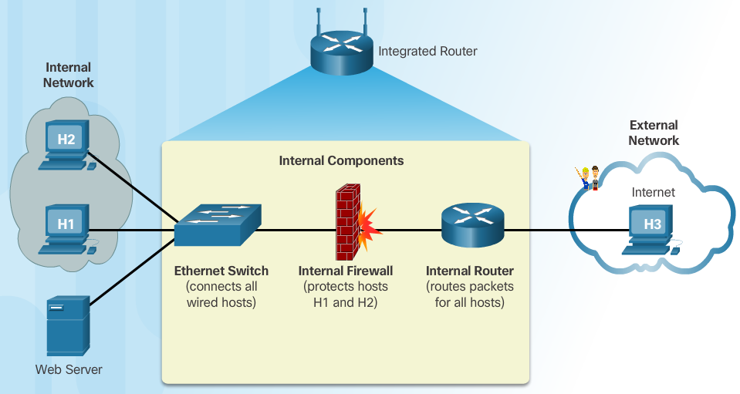
Physical Components of a Network Network Devices
Modems convert a computer’s digital data into a format that can be transmitted on the ISP’s network.
Switches microsegment LANs by sending data only to the computer that needs it.
Wireless access points (APs) connect wireless devices. Routers use IP addresses to forward traffic to other networks.
In a home or small office, a route often includes a switch, a firewall, and an AP.
Notes:
7.3 - Physical Components of a Network
7.3.1 - Network Devices

Slide 22
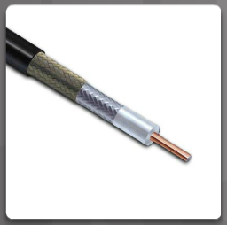
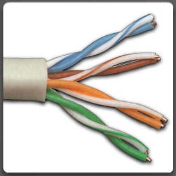
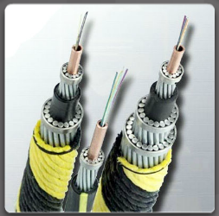
Physical Components of a Network Cables and Connectors
Coaxial and twisted-pair cables use electrical signals over copper to transmit data. Fiber-optic cables use light signals to transmit data. These cables differ in bandwidth, size, and cost.
There are several types of coaxial cable: 10Base5 (thicknet), 10Base2 (thinnet), RG-59 (cable TV), RG-6 (better than RG-59)
Twisted-pair cables are terminated with an RJ-45 connector. Twisted-pair comes in two types:
Unshielded Twisted-Pair (UTP)
Shielded Twisted-Pair (STP)
Fiber-optic cables are broadly classified into two types:
Single-mode fiber (SMF) - Uses lasers to send a single ray of light that can travel hundreds of kilometers.
Multimode fiber (MMF) - Uses LEDs to send multiple light signals that can travel up to 550 meters.
Notes:
7.3 - Physical Components of a Network
7.3.2 - Cables and Connectors

Slide 23
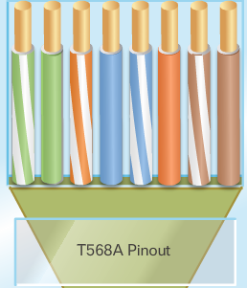
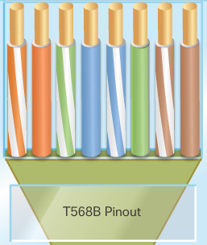
Physical Components of a Network Cables and Connectors
Twisted-pair is the most popular type of cabling used in LANs today.
There are two different twisted-pair wiring schemes: called T568A and T568B.
Each wiring scheme defines the pinout, or order of wire connections, on the end of the cable.
Two types of cables can be created: a straight-through cable and a crossover cable.
A straight-through cable is the most common cable type. The wiring scheme is the same on both sides.
A crossover cable uses both wiring schemes. T568A on one end of the cable and T568B on the other end of the same cable.
Notes:
7.3 - Physical Components of a Network
7.3.2 - Cables and Connectors

Slide 24
7.4 Basic Networking Concepts and Technologies
Notes:
Cisco Networking Academy Program
IT Essentials
Chapter 7: Networking Concepts

Slide 25
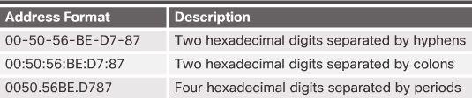
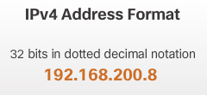
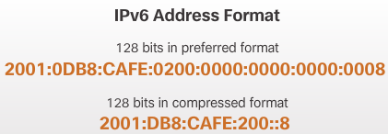
Basic Networking Concepts and Technologies Networked Equipment Addressing
The MAC address is hard coded onto the network interface card (NIC) by the manufacturer.
The MAC address is 48 bits represented in hexadecimal
The Internet Protocol (IP) address is assigned by network administrators based on the location within the network.
Two versions of Internet Protocol (IP) Addressing:
IPv4: 32-bit represented in dotted-decimal
IPv6: 128-bit represented in hexadecimal
Notes:
7.4 - Basic Networking Concepts and Technologies
7.4.1 - Networked Equipment Addressing

Slide 26
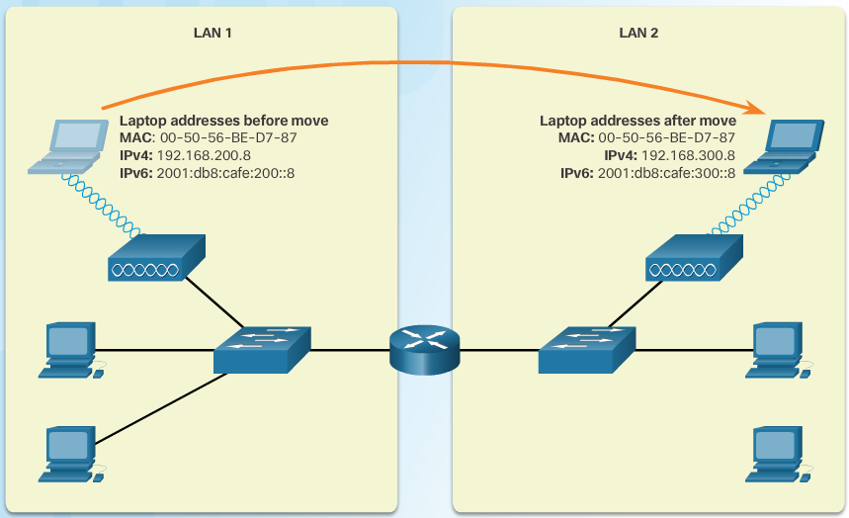
Basic Networking Concepts and Technologies Networked Equipment Addressing
Host devices need both addresses to communicate on the network.
MAC addresses do not change when devices move from one network to another.
IP addresses change because they are based on where the device is in the network.
Notes:
7.4 - Basic Networking Concepts and Technologies
7.4.1 - Networked Equipment Addressing

Slide 27
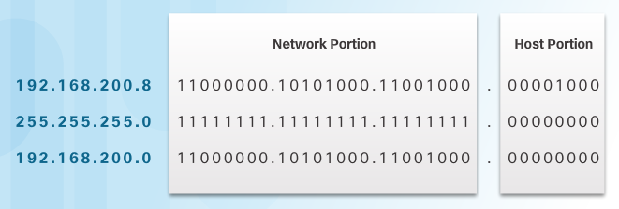
Basic Networking Concepts and Technologies Networked Equipment Addressing
An IPv4 address is composed of two parts. The first part identifies the network. The second part identifies a host on that network.
Computers and routers use the subnet mask to calculate the network portion of the destination IPv4 address.
A one bit in the subnet mask means that bit is part of the network portion. So the first 24 bits of the 192.168.200.8 address are network bits. The last 8 bits are host bits.
Notes:
7.4 - Basic Networking Concepts and Technologies
7.4.1 - Networked Equipment Addressing

Slide 28
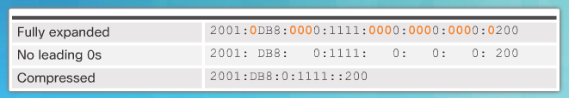
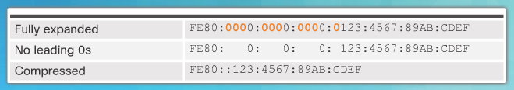
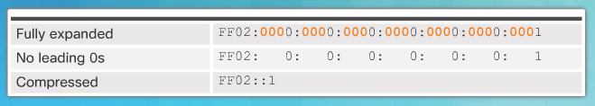
Basic Networking Concepts and Technologies Networked Equipment Addressing
Two rules help reduce the number of digits needed to represent an IPv6 address.
Rule 1 - Omit Leading 0s
Rule 2 – Omit All 0 Segments
Notes:
7.4 - Basic Networking Concepts and Technologies
7.4.1 - Networked Equipment Addressing

Slide 29
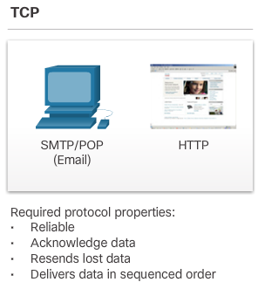
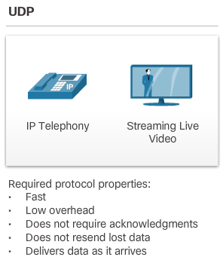
Basic Networking Concepts and Technologies Transport Layer Protocols
The two protocols that operate at the transport layer are Transport Control Protocol (TCP) and User Datagram Protocol (UDP)
TCP is considered reliable, because it ensures that all of the data arrives at the destination.
UDP does not provide for any reliability.
Notes:
7.4 - Basic Networking Concepts and Technologies
7.4.2 - Transport Layer Protocols

Slide 30
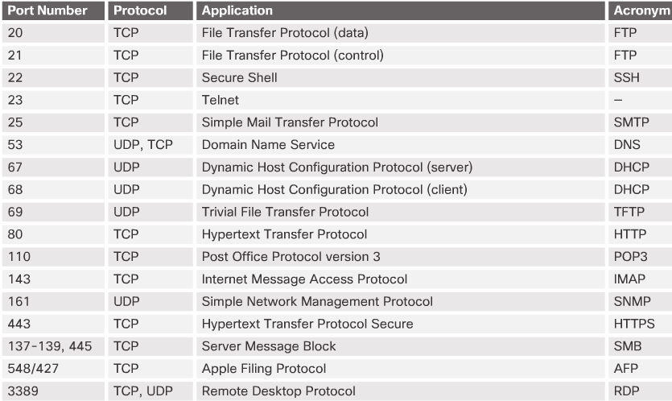
Basic Networking Concepts and Technologies Transport Layer Protocols
TCP and UDP use a source and destination port number to keep track of application conversations.
The destination port number is associated with the destination application on the remote device.
The source port number is dynamically generated by the sending device.
Notes:
7.4 - Basic Networking Concepts and Technologies
7.4.2 - Transport Layer Protocols

Slide 31
7.5 Chapter Summary
Notes:
Cisco Networking Academy Program
IT Essentials
Chapter 7: Networking Concepts

Slide 32
Chapter Summary Summary
This chapter introduced the operation of computer networks. The following concepts from this chapter are important to remember:
Computer devices and components include host devices, intermediary devices, and media.
Major network types include LANs, WLANs, PANs, MANs, WANs, Peer-to-Peer, and Client-Server
Networking standards are conceptually organized into two reference models: the OSI model and the TCP/IP model
Wired networks use CSMA/CD when operating in half-duplex. Wireless networks use CSMA/CA.
Network devices include modems, switches, wireless APs, routers, and firewalls.
Network media includes coaxial cables, twisted-pair cables, and fiber-optic cables. Wireless signals are also considered media.
The two twisted-pair wiring schemes are T568A and T568B.
Devices need a physical address (MAC) and a logical address (IP) to communicate on the network.
The transport layer includes the two protocols, TCP and UDP. TCP is reliable but introduces overhead that is not used with UDP.
The transport layer tracks conversations between applications using source and destination port numbers.
Notes:
7.5 – Chapter Summary
7.5.1 - Conclusion

Slide 34
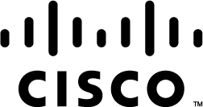

Slide 35
Chapter 7 New Terms and Commands
aes
algorithm
backoff (ethernet)
baseband
binary
braid
cidr
coax
coaxial
collision (ethernet)
congestion
crossover
crosstalk
csma
dc
encapsulation
mdf
microsegments
mmf
mnemonics
repeaters
rfi
supernet
t568a
t568b
terminated (cabling)
thicknet
thinnet
udp
utp
wep
wlan
wpa
wpa2
Notes:
New Terms and Commands

